Slide 1
Training for [School Name]
Notes:
Add your school name and presenter name.

Slide 2
CurbSmart Overview
Online application designed to manage the [arrival and] dismissal of students [to and] from school.
Accessible on any device with an internet connection.
Available as a mobile app for Apple and Android
Notes:
Text in brackets [ ] throughout the presentation are notes or additional comments that should be reviewed and modified before sharing this presentation to your staff. On this slide, if your school does not use the Arrivals feature to track morning check-ins, then omit the text in the point above.

Slide 3
Types of Roles [One-Release Method]
Entry Admin – Responsible for entering placards at their designated pickup location as parents arrive in the car line.
Inside Admin – Responsible for releasing students from the classroom [or holding area, such as the gym, cafeteria, library.]
School Admin – Responsible for adding or updating student records, adding student ride changes, changing users and filters, viewing reports, etc.
Notes:
Use this slide if your school uses the one-release method (Entry and Inside Admins only).

Slide 4
Types of Roles [Two-Release Method]
Entry Admin – Responsible for entering placards at their designated pickup location as parents arrive in the car line.
Inside Admin – Responsible for releasing students from the classroom [or holding area, such as the gym, cafeteria, library.]
Outside Admins – Responsible for releasing students from the pickup location to the cars after they have been released by the Inside Admins.
School Admin – Responsible for adding or updating student records, adding student ride changes, changing users and filters, viewing reports, etc.
Notes:
Use this slide if your school uses the two-release method (Entry, Inside and Outside Admins).

Slide 5
General Process (Car Riders) [One Release]
Parents arrive in car line; hangtag is displayed in rearview mirror.
01
Entry Admin enters the placard in the order the parents arrive.
02
Inside Admins release students as they dismiss from their holding area.
03
Notes:
Parents place their assigned hangtag on their rearview mirror. As they pull into the carline, the Entry Admin enters the number into CurbSmart. Inside Admins see the students appear in their view in the order they are entered and releases them when the student leaves their area.

Slide 6
General Process (Car Riders) [Two Release]
Parents arrive in car line; hangtag is displayed in rearview mirror.
1
Entry Admin enters the placard in the order the parents arrive.
2
Inside Admins release students as they dismiss from their holding area.
3
Outside Admins release students as they get into their cars.
4
Notes:
Parents place their assigned hangtag on their rearview mirror. As they pull into the carline, the Entry Admin enters the number into CurbSmart. Inside Admins see the students appear in their view in the order they are entered and releases them when the student leaves their area. Outside Admins see the students appear in their view in the order they are released by the Inside Admins. They press the release button as students are released to their car.

Slide 7
Our Process (Car Riders)
[Include specific details and instructions for your school’s dismissal flow. This could include the pickup locations, time that dismissal starts, where students are being held, or any other key information.]
Notes:
Customize this slide by replacing the CurbSmart car logo with your school’s logo.

Slide 8
Walkers
[Include instructions on how walkers should be released, if applicable to your school. Example below.]
Walkers are pre-loaded in the Inside Admin screens at the beginning of dismissal. Students assigned as walkers will have a “Walker” label next to their name. At the designated time, release walkers from your holding area.
Notes:
Remove this slide if your school does not use CurbSmart to dismiss walkers.

Slide 9
Bus Riders
[Include instructions on how bus riders should be released, if applicable to your school.]
If you use ALL-CALLS to announce when bus riders are ready to leave, describe that process.
If you use BUSES in CurbSmart, then include instructions on how Inside Admins will see bus riders in their view on the Release to Bus tab.

Slide 10
Bus Riders (All-Calls)
All users will see a red message at the top of the screen when students are ready to be dismissed to their bus.
Notes:
If your school releases bus students using the All-Call feature, use this slide and modify it with your school’s instructions. Note that when the all-call is used to call buses, teachers will not see specific names of students who are riding the bus.

Slide 11
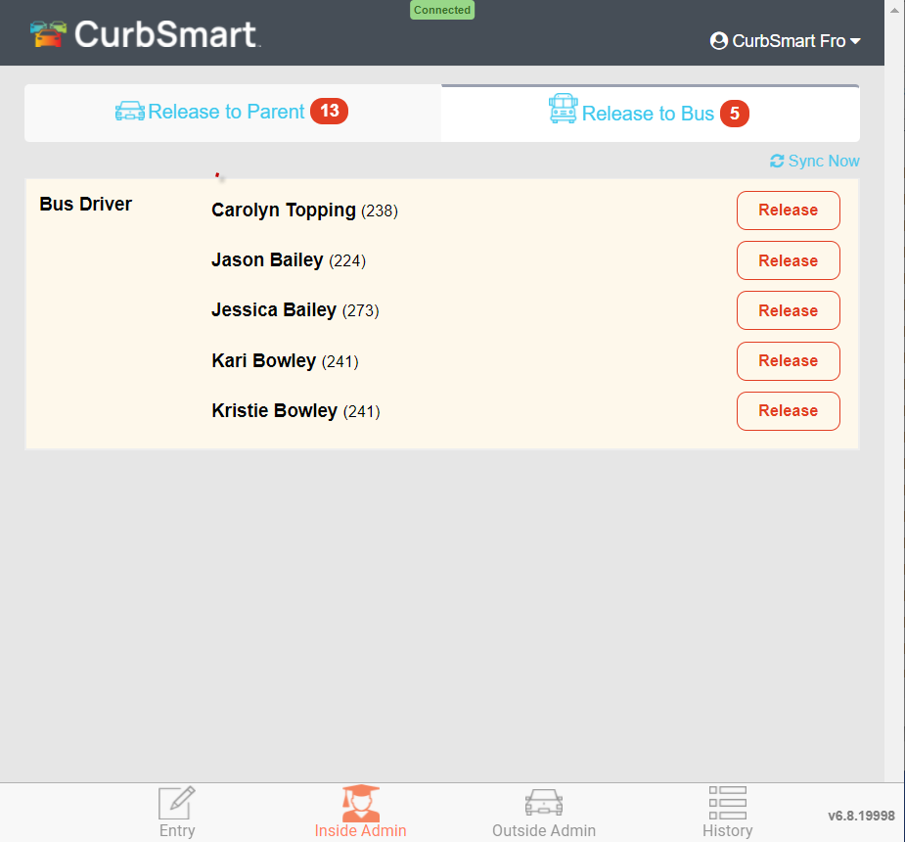
Bus Riders (using Release to Bus tab)
Bus students will appear on the Release to Bus tab on the Inside Admin screen when the bus is entered by the Entry Admin.
Inside Admins will see the students within their applied filter grouped by bus number.
Inside Admins will press “Release” as students leave their holding area and head to the bus.
Notes:
If your school has bus students pre-loaded when the process starts, then you can adjust the first point to read “Bus students will appear on the Release to Bus tab on the Inside Admin screen when the process starts in CurbSmart.”

Slide 12
Other Pickup Types
[Include instructions for any other pickup type (or release method) not already mentioned for your school.]
Notes:
Use this slide to include instructions on how students are released to other areas, whether you’re using CurbSmart for that process or not.

Slide 13
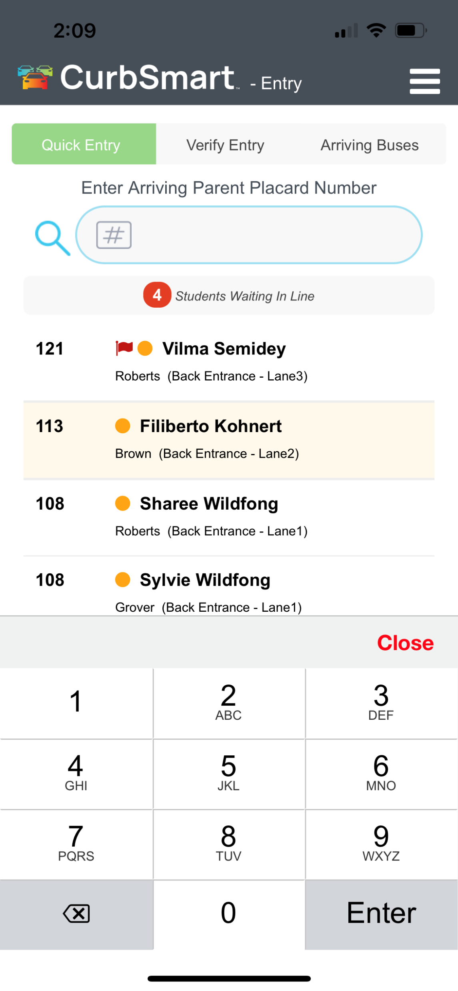
Entry Admins – Things to Know
Entry Admins initiate the process in CurbSmart by pressing the ‘Begin Release’ button.
You can have multiple Entry Admins per location, but only one Entry Admin needs to press ‘Begin Release.’
We recommend logging in on the CurbSmart App (or mobile browser) and using cell service for best results.
Notes:
These are helpful reminders regarding the Entry Admin role. Regarding the last point, this depends on your school. We have found that if Entry Admins are connected to Wi-Fi and are outside the building, the signal can be weak and affect the speed of entering numbers. We recommend turning off Wi-fi on the device during dismissal so that the phone isn’t trying to constantly establish a connection.

Slide 14
Entry Admins (Cont.)
Quick Entry: Placard is entered and immediately appears in Entry List and Inside Admin screens
Verify Entry: Placard is entered and reviewed before it appears in the Entry List.
Arriving Buses: Depending on your school’s settings, bus numbers will be entered on this tab.
Search by Name: Click the magnifying glass to the left of the entry field to search for a student by name.
Undo Entry: Swipe left on the student’s name, then press the trash can to remove the student(s) on this placard from the list.
Student All-Call: Swipe left and click the bull-horn to make an all-call, or announcement, regarding this student.
Notes:
If your school doesn’t use the bus feature, or if bus students are pre-loaded in the Inside Admin screen, you can remove the section on Arriving Buses.

Slide 15
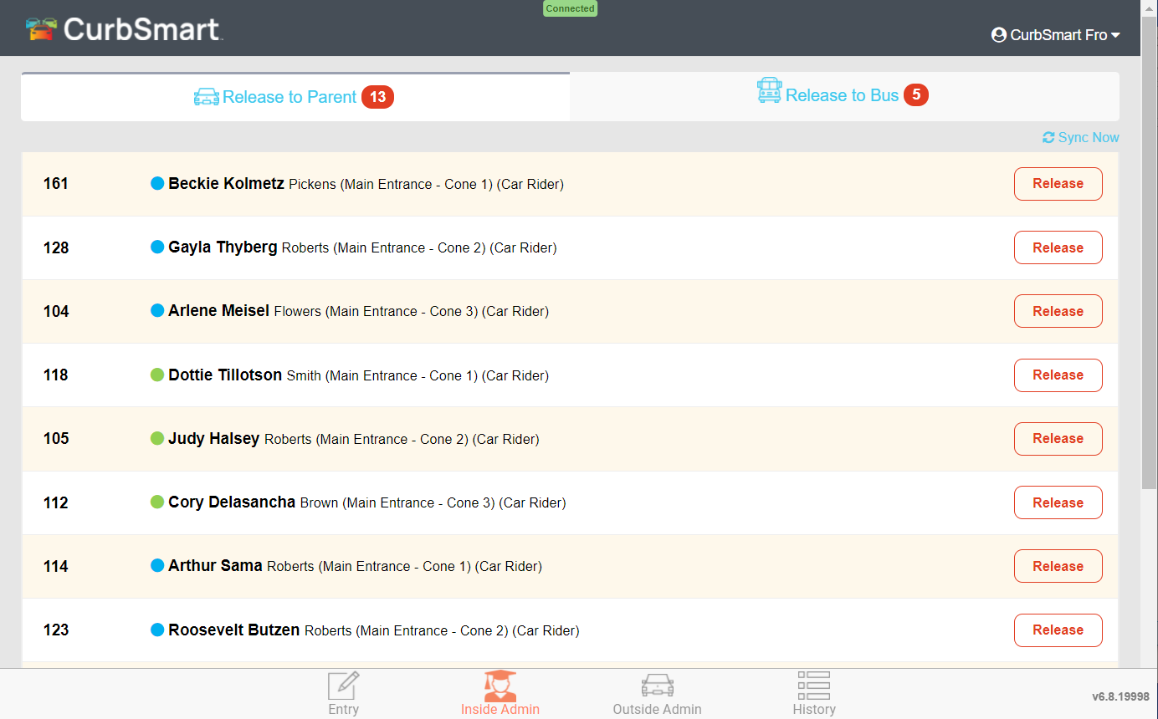
Inside Admins – Things to Know
Students appear in the order they are entered by the Entry Admin.
You will only see students that belong to your filter [include a note about how filters are set for your school].
Pay attention to the details on the student’s row and communicate any pickup location information to the student before you release them.
Log out at the end of each day!
Notes:
These are helpful reminders regarding the Inside Admin role. If an Inside Admin has a filter applied but still sees all students on the Inside Admin view, have them log out/in once to re-apply the filter.

Slide 16
Inside Admin (Cont.)
Mark as Absent: Swipe left on the student’s name and press the Mark as Absent button to mark the student as absent for the day and remove them from your view.
Adjust font size: Click the menu in the top right corner, then Font Settings to make the text larger/smaller.
Notifications: When you login for the first time on the app or computer browser, you’ll be prompted to allow notifications. Choose “Allow”, then click on Menu > Notifications and select the type of notifications you’d like to receive.
Notes:
Not listed above, but worth noting: If an Inside Admin swipes left on a student row, they will also see an option to add an All-Call or Move a Student Back (undo entry). If desired, both settings can be disabled for Inside Admins from User Management > Edit User > User Settings > “Allow Send All-Calls” and “Enable Stepback”.

Slide 17
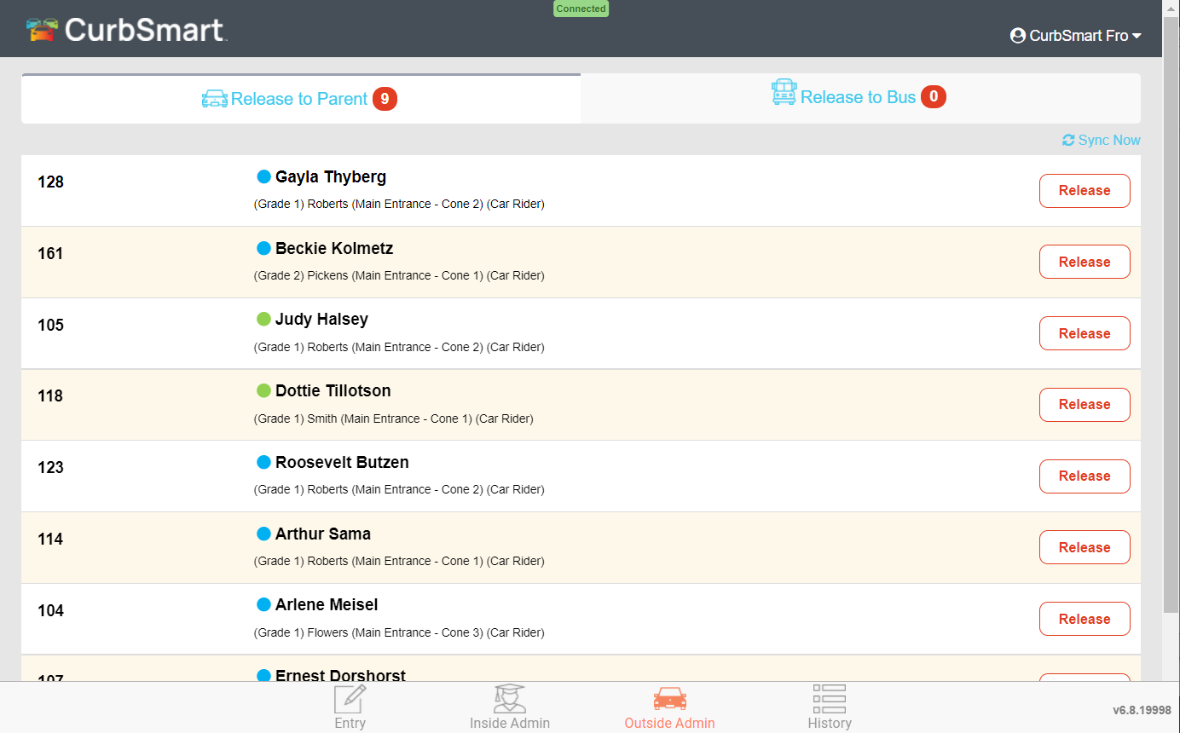
Outside Admin - Things to Know
Students appear in the order they are released by the Inside Admins (NOT the order they are entered into CurbSmart).
Pay attention to any other details on the student row (i.e. Pickup Location, pickup type, etc.). Communicate to the student where they should go before you tap Release.
Log out at the end of each day!
Notes:
Omit this slide if your school uses one-release (Entry and Inside Admins only).

Slide 18
Outside Admins (Cont.)
Adjust font size: Click the menu in the top right corner, then Font Settings to make the text larger/smaller.
Notifications: When you login for the first time on the app or computer browser, you’ll be prompted to allow notifications. Choose “Allow”, then click on Menu > Notifications and select the type of notifications you’d like to receive.
Notes:
Omit this slide if your school uses one-release (Entry and Inside Admins only). Not listed above, but worth noting: If an Outside Admin swipes left on a student row, they will also see an option to add an All-Call or Move a Student Back (undo entry). If desired, both settings can be disabled for Outside Admins from User Management > Edit User > User Settings > “Allow Send All-Calls” and “Enable Stepback”.

Slide 19
Additional Notes
[Include any additional notes for your team here.]

Slide 20
How to Login to CurbSmart
[Include instructions on how login credentials will be provided to teachers and staff.]
Notes:
Usernames can be found in the CurbSmart Admin panel under System Settings > User Management. Most often, usernames are the same as the teacher’s emails. There is also a button to email login info to all users, which will send them an email with their username and password

Slide 21
Next Steps & Questions?
Login at www.curbsmart.net on a browser or download the CurbSmart app from the App or Google Play stores.
Practice Run!
Notes:
If time permits, we recommend running a practice flow. Have your Entry Admins enter random numbers. Have Inside Admins login and verify they see the students that belong to their filter. Have them release their students so that Outside Admins (if used) can view the students as they are released by the Inside Admins from the holding areas.

